Slide 1
Vehicle Dynamics and Simulation
Drivetrain Dynamics
Dr B Mason

Slide 2
Lecture overview

Slide 3
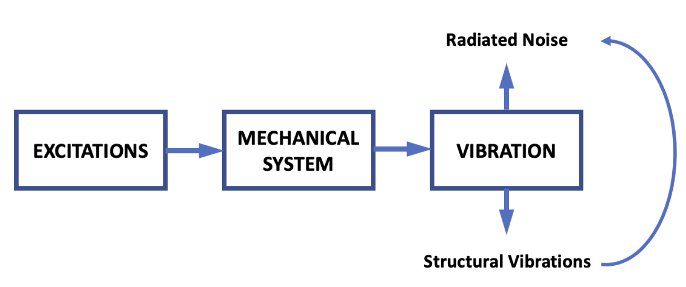
The Drivetrain System

Slide 4
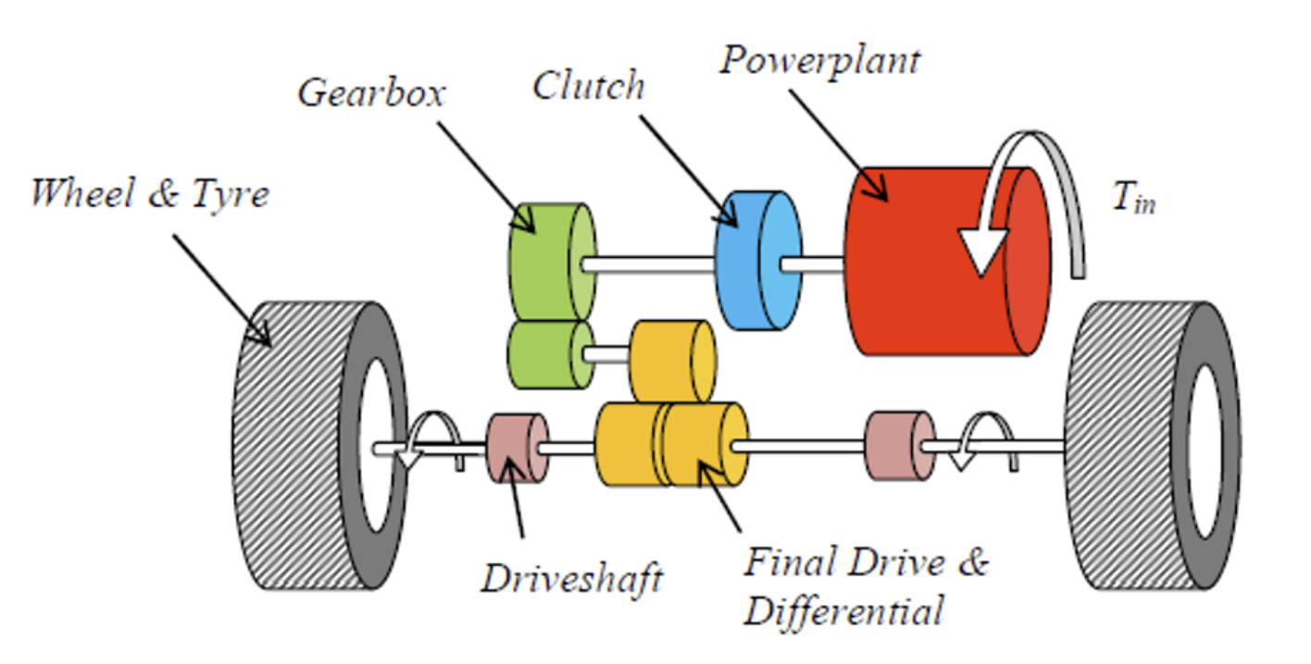
The Drivetrain System

Slide 5
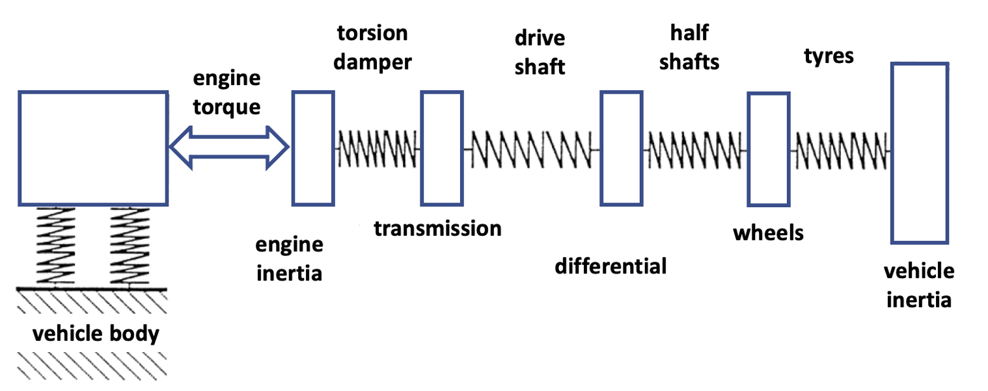
The Drivetrain System
The drivetrain can be represented as a number of springs and masses
Each mass is isolated as a point-mass
These types of models are known as lumped parameter models
Control of vibration is achieved by;
Reducing excitation
Changing stiffness and damping (resonance frequencies)

Slide 6
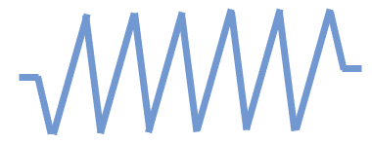
The simplest useful model
Three main modes;
Shuffle (4-12 Hz)
Rattle (40 – 80 Hz)
Rigid body rotation
And others;
Boom (interior compartment)
Judder (low frequency on clutch engagement)
Clonk (lash in driveline)
Engine inertia
Transmission
Vehicle inertia
Torsion
damper
Drive-
train
shuffle
rattle

Slide 7
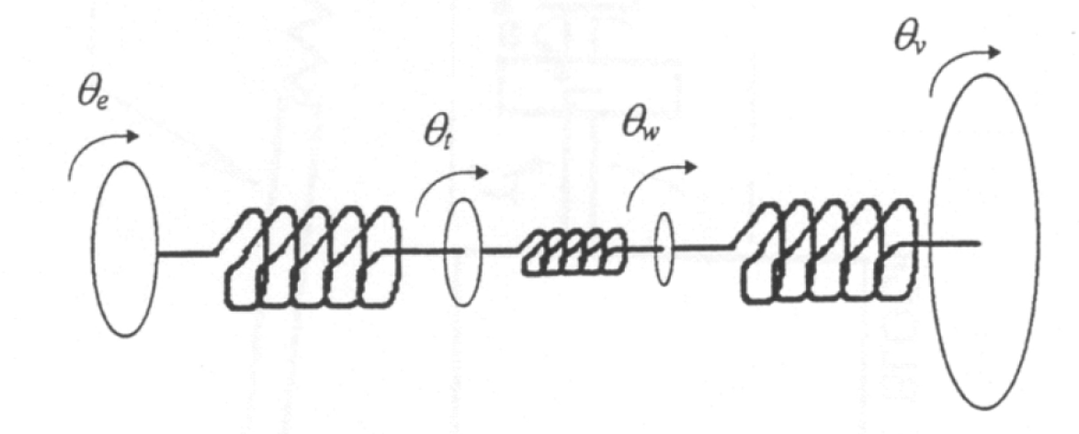
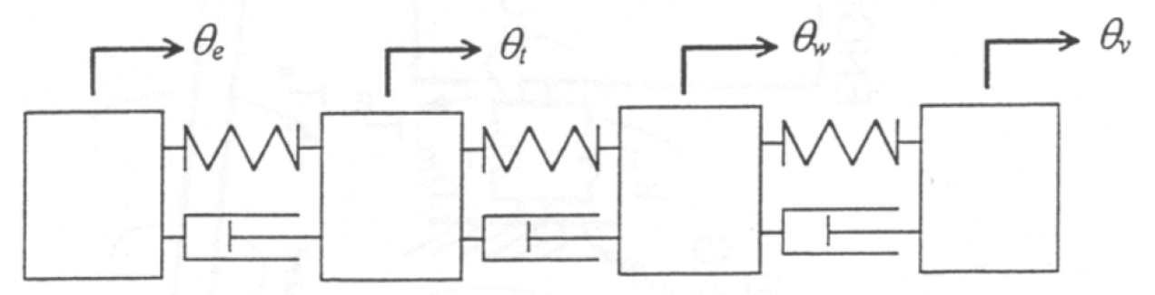
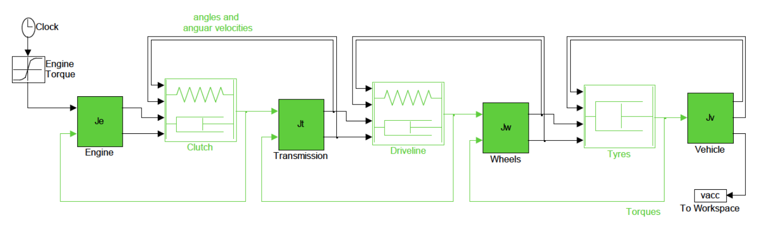
More advanced models
Three, four, six, …, twenty mass models
Complexity driven by requirements
Can add masses to suit
Other components in the drivetrain are important
Clutch
Differential
Actuators and related controls

Slide 8
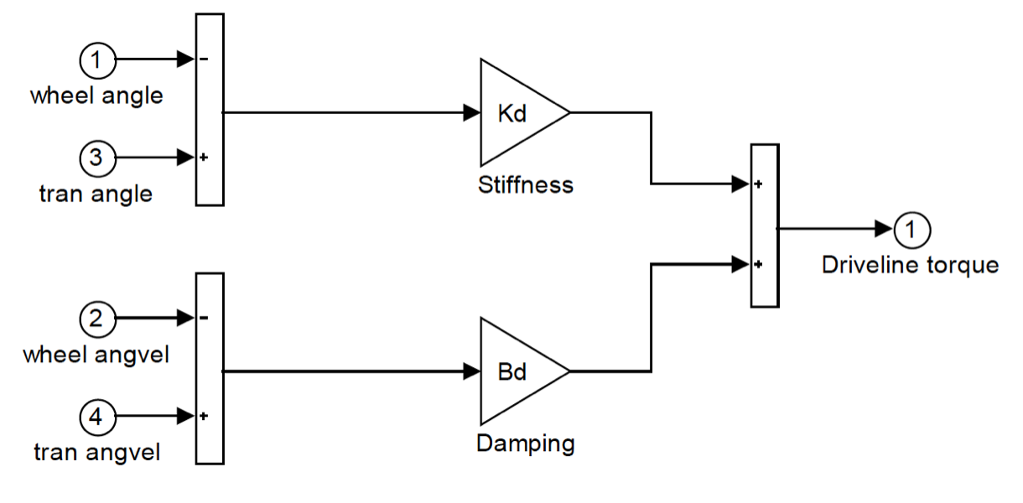
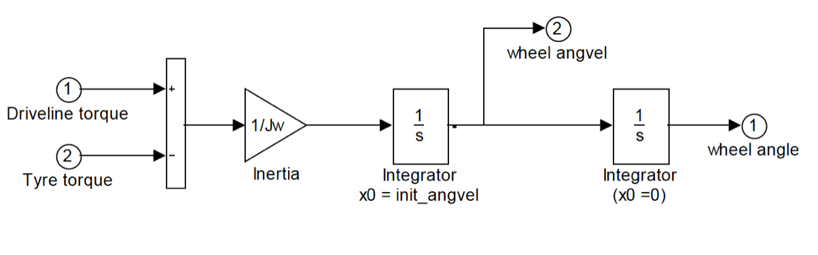
Standardised components
Spring-damper
Mass

Slide 9
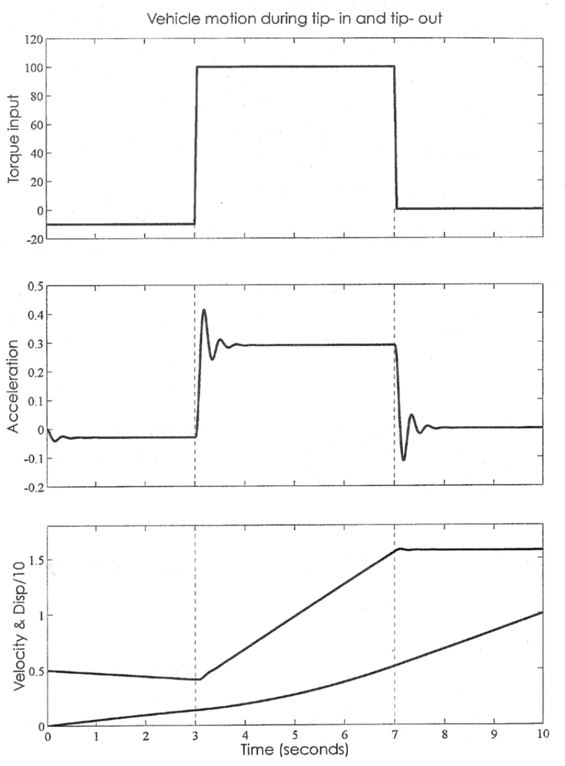
Response to step input

